Slide 1
What’s Love Got to Do with It?

Slide 2
Welcome to Charlottesville!

Slide 3
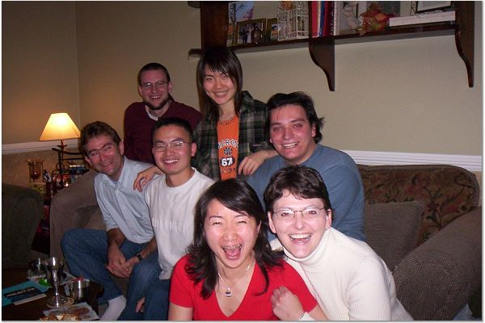
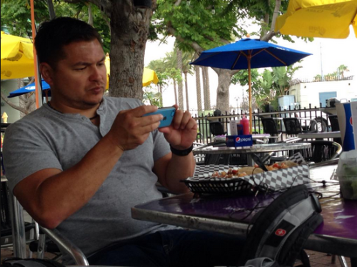
Reality sets in.

Slide 5
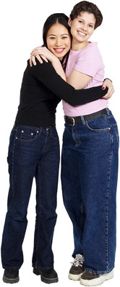
Make an American friend.
Talk to classmates/colleagues/neighbors.
Invite to eat lunch.
ISI activities
ISI Friendship Partners
International Center activities.

Slide 6
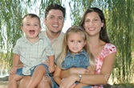
Key Phrase to Use:
“I’m interested in getting to know Americans.”

Slide 7
Work on Your English!
Talk! Invite corrrections.
Classes

Slide 8
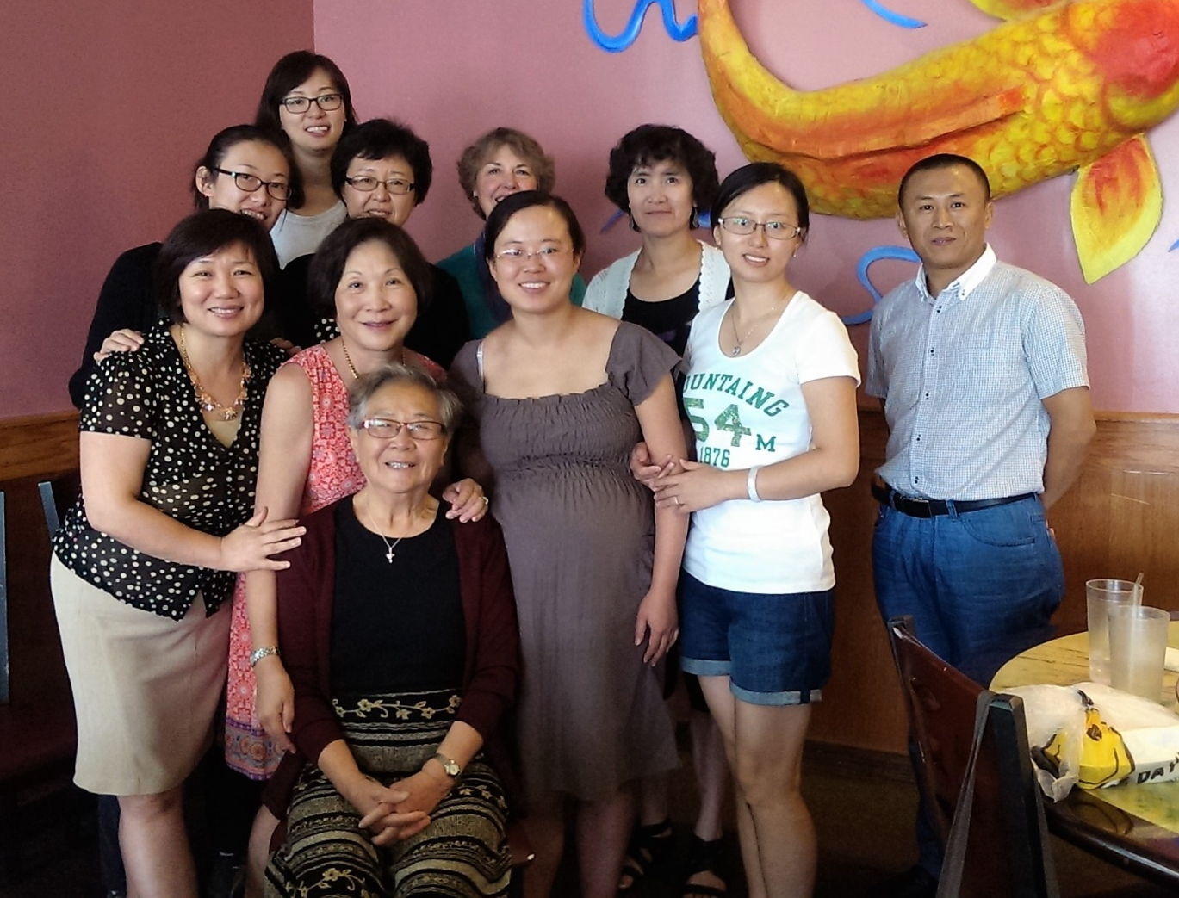
Bible Study

Slide 9
Lorna Sundberg International Center
Conversational English Classes
Many activities to try
Chances to volunteer
Get to know people from all over the world

Slide 10
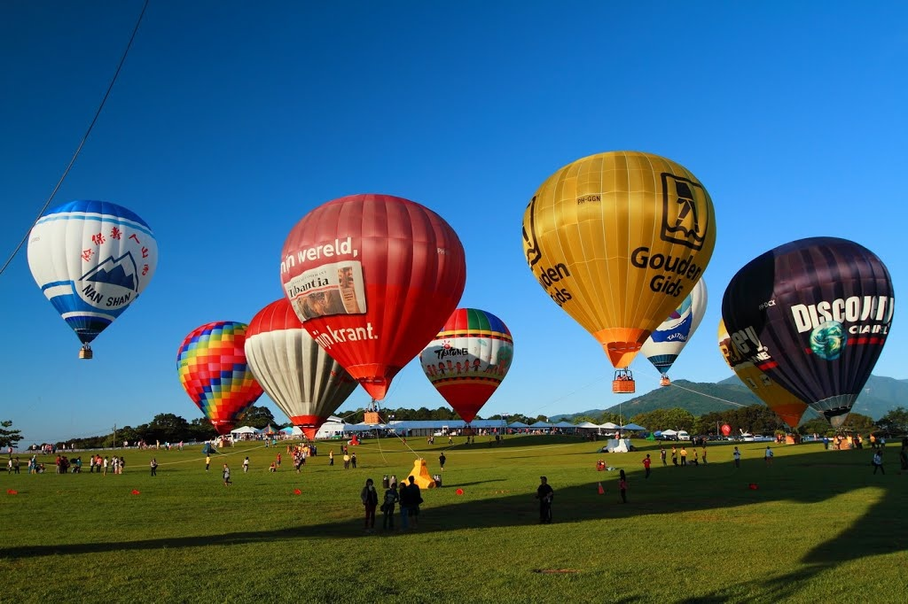
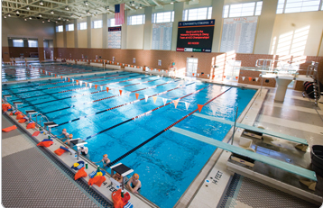
Try a New Activity

Slide 11
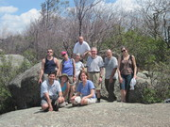
Look for Events and Clubs at UVA

Slide 12
Explore Christianity

Slide 13
Obstacles
Time
Money
Fear

Slide 14
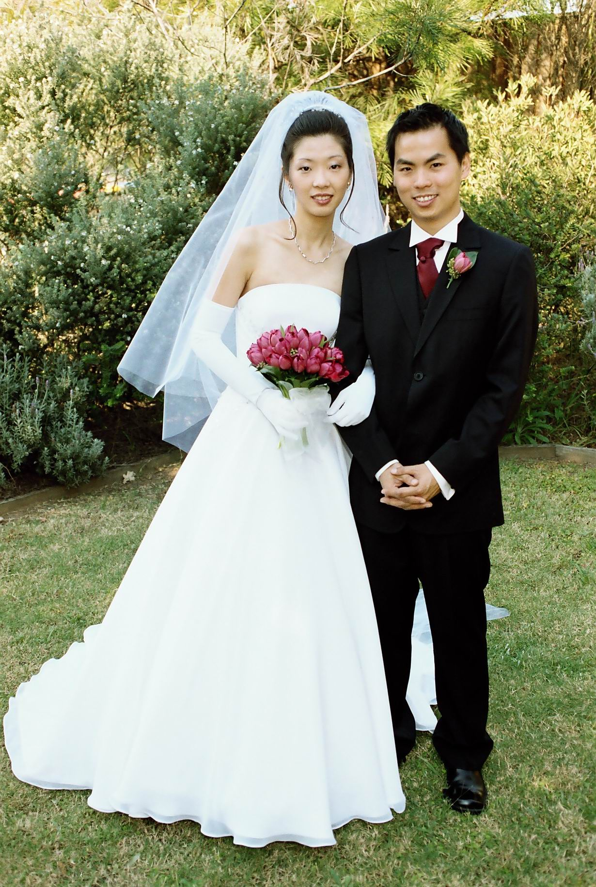
Strengthen Your Marriage

Slide 15
If your spouse has come with you, he/she has come with high expectations. Reality:
You | Spouse
No Time | Lots of time
Around people all day | Stuck alone in apartment
Building career | Career on hold
Identity as scholar | Who am I?

Slide 16
Leads to
Anger
Frustration
Accusations
Lack of understanding
Shame that marriage isn’t better
Poor communication

Slide 17
You | Spouse
Much work stress Maybe little sleep Spouse has an easy life. | He/she doesn’t understand my sacrifice. Wonder why I came

Slide 18
What can I do?
If you are the scholar, you might not have much time, but -
Listen
Express appreciation
Ask how he/she would like you to show appreciation

Slide 19
What can I do? (continued)
A daily 15-minute walk
A weekly date night
A monthly time to explore C’ville together
Ask what he/she would like.

Slide 20
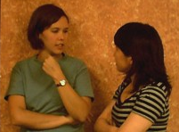
What can I do? (continued)
Encourage your wife/husband to make friends and participate in activities on his/her own.
Talk about his/her strengths.
Share your own needs, concerns and fears.

Slide 21
What if I’m the Spouse?
Get out of your comfort zone!
Consider what you can try and learn that will enhance your career back in China.
Be grateful for this time to serve your spouse and build a strong family.
Release your spouse from being responsible for your happiness.
Share your needs, concerns and fears.
Ask how you can best help and listen!

Slide 22
Communicate!

Slide 23
Obstacles to Communication
Time
Anger
Fear

Slide 24
Fear
Keeps us from trying new friendships and new experiences
Inhibits our communication

Slide 25
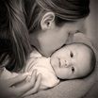
Only love is greater than fear.
There is no fear in love. But perfect love drives out fear, because fear has to do with punishment. The one who fears is not made perfect in love.
1 John 4:18

Slide 26
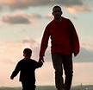
How do we feel when we know we are loved?
Confident
Safe
Brave
Willing to try new things

Slide 27
Is family love enough to free me from my fears?
Rejection
Failure
Loneliness
Shame
Loss of Self
Intimacy

Slide 28
God is love. 1 John 4:16
Knows and controls the future.
Loves me.

Slide 29
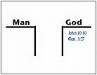
God is far away. I am separated from Him.
He is holy. I am unclean in my thoughts.
He is love. I am unloving in many relationships.
I am ashamed because I have failed in so many ways.

Slide 30
Trying hard didn’t work.
God understands our human weakness.
God took the first step by sending His Son Jesus.
Failures = Sins

Slide 31
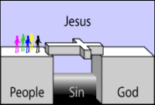
Jesus showed what love is.
This is love: not that we loved God, but that He loved us and sent His son as an atoning sacrifice for our sins. 1 John 4:10

Slide 32
God wants to be our generous father!
How great is the love the Father has lavished on us, that we should be called children of God!
1 John 3:1

Slide 33
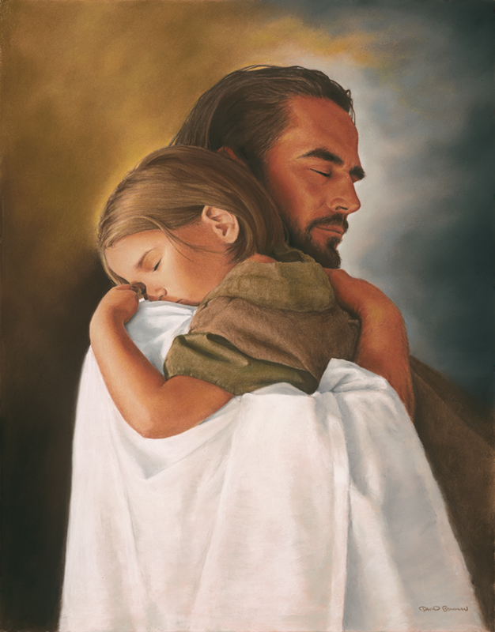
To become God’s beloved child, you -
Yet to all who received Him, to those who believed in His name, He gave the right to become children of God. John 1:12

Slide 34
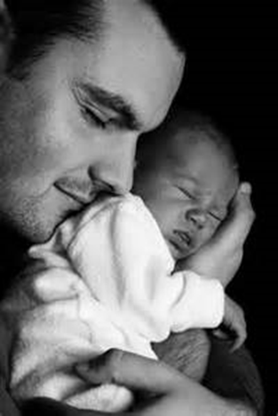
Love
Who shall separate us from the love of Christ? Shall trouble or hardship or persecution or famine or nakedness or danger or sword? … No, in all these things we are more than conquerors through Him who loved us. Romans 8:35-37

